Slide 1

Team
OptiPark
Team Lead : Narasimha Ampavalli
Problem Statement : In urban environments, finding available parking contributes significantly to traffic congestion, driver stress, and increased emissions. Traditional parking systems lack real-time detection and prediction, leading to inefficiencies.

Slide 2
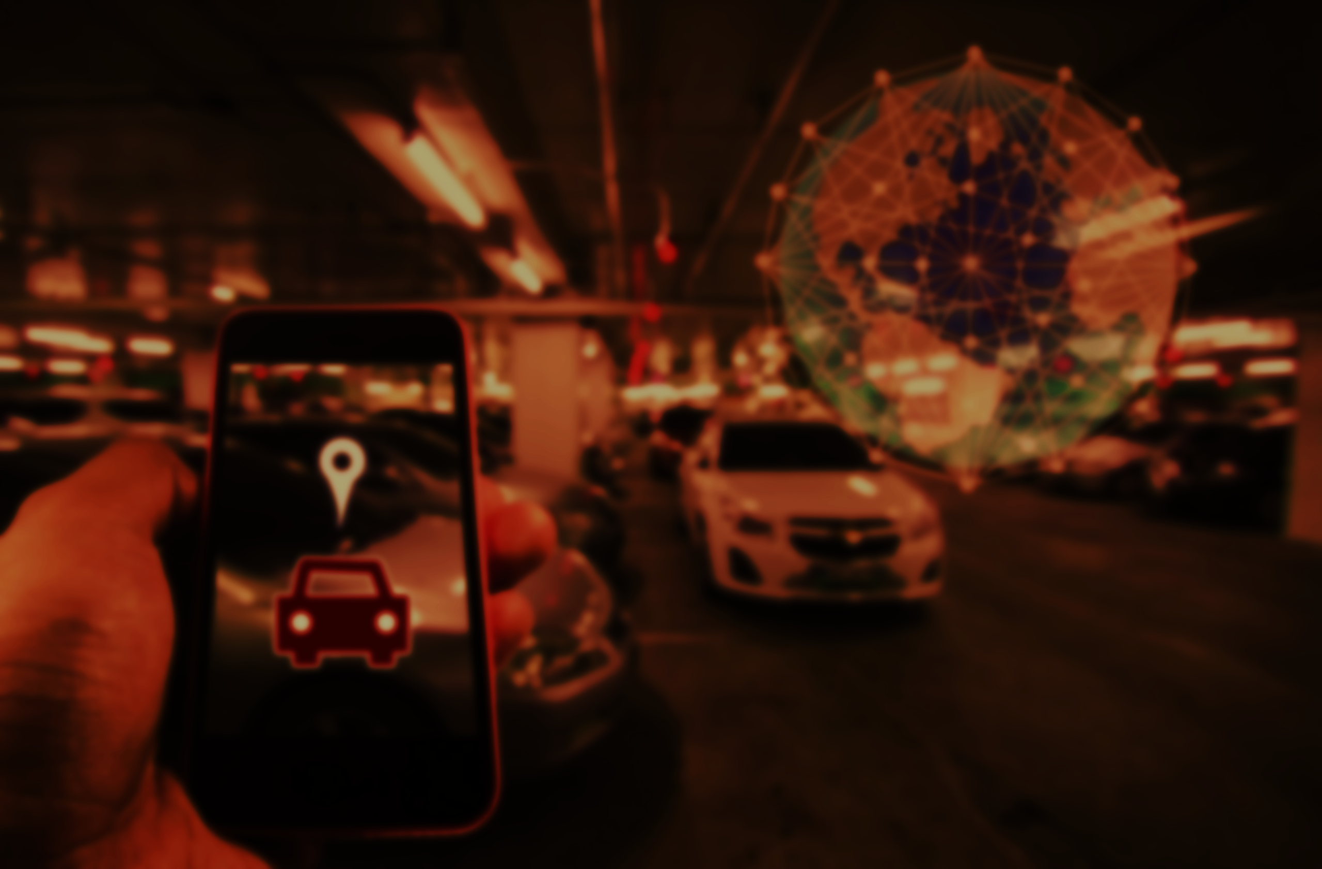
Objective:
“Develop an AI-powered system to detect and predict parking availability in real-time, helping drivers efficiently locate parking spots and reduce urban congestion.”

Slide 3
Differentiation: Emphasize the use of real-time AI-based detection and predictive analytics, unlike traditional static parking apps.
Problem-Solving Potential: Outline how it minimizes search time, traffic, and emissions.
Unique Selling Point (USP): Dynamic pricing, customized driver recommendations, and adaptability based on environmental factors (e.g., weather and events).
Opportunities

Slide 4
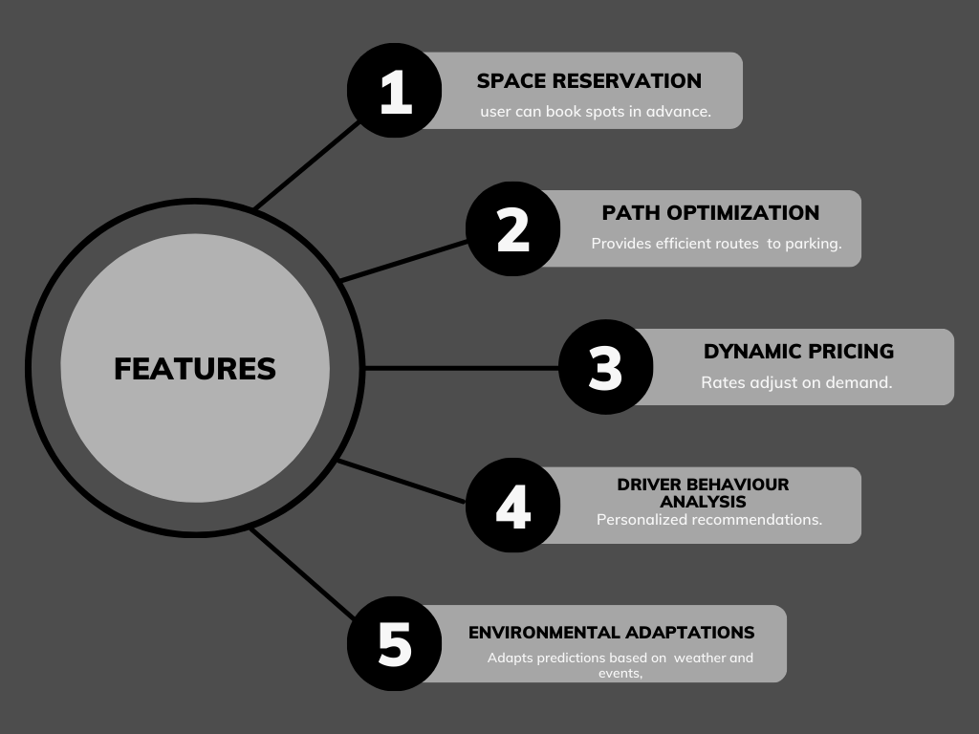

Slide 5




Technology used
Computer Vision (YOLO or CNN): For real-time detection.
Predictive Analytics (LSTM): Forecasts spot availability based on historical data.
IoT Sensors: Ensures real-time accuracy.
Cloud Infrastructure: Supports data processing and updates.

Slide 6

Practical Feasibility
Ease of Integration
User-Friendly Interface
Scalable technologies fit current infrastructure.
Accessible via mobile and web.
Predictive Accuracy
Environmental Impact
Proven model ensure reliable predictions.
Reduces emissions by cutting down idle times.

Slide 7
Innovation and Creativity:
Dynamic Pricing
Reservation & Path Optimization
Behaviour Analysis
Environmental Adaptation
Adjusts based on demand.
User convenience through bookings and directions.
Personalizes recommendations
Predicts availability based on events/weather.

Slide 8
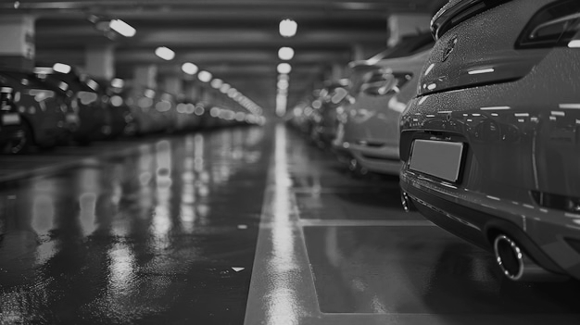
Real - World Impact
Traffic Reduction
Reduces search times.
Driver Experience
Simplifies parking search.
Space Optimization
Efficient usage of parking
Environmental Benefit:
Reduces emissions from decreased idle time.

Slide 9
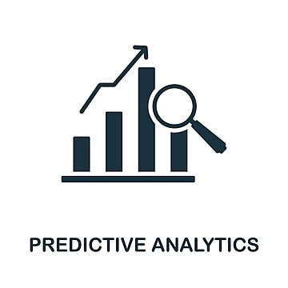

Distinctive Aspects
Predictive Analytics
1
Forecasts availability.
Personalized Recommendations
2
Custom guidance.
Dynamic Pricing
3
Enhances space usage.
Local Data Integration
4
Uses weather/event data for accuracy.
Predictive Analytics: Forecasts availability.
Personalized Recommendations: Custom guidance.
Dynamic Pricing: Enhances space usage.
Local Data Integration: Uses weather/event data for accuracy.

Slide 10
End-to-End Process:
01
02
03
04
Detection
Prediction
Guidance
Feedback
Spots available spaces.
Forecasts future availability.
Provides direction and booking options.
Iterative improvement of the model.

Slide 11
Conclusion
"OptiPark redefines urban parking by combining AI-driven predictions with real-time data to provide a seamless parking experience. By reducing search times and emissions, OptiPark supports smarter, greener cities while enhancing driver convenience. With OptiPark, finding a parking spot becomes efficient, sustainable, and stress-free—paving the way for a smarter urban future."

Slide 12
"Thank you for your time and consideration. We are excited to bring innovative, smart parking solutions to life, and we welcome any questions you may have."
— Team Optipark

